Slide 1
Notes:
Front Cover Slide

Slide 2
Change Leads to Success
Sector-Driven Customized Training Solutions
Cathy Clower and Ryan Skinner
Notes:
Today we are going to discuss how a system change led to a customized training initiative and provided opportunities for VR consumers.

Slide 3
Introduction
Change Leads to Success

Slide 4
Change in System
Customized Training
Success
Notes:
We will discuss in detail how WIOA strengthened our alignment with partners and led to us becoming part of the sector strategies approach.
We will also talk about how being part of this new approach to workforce development led to a customized training initiative that has resulted in successful employment for VR consumers.

Slide 5
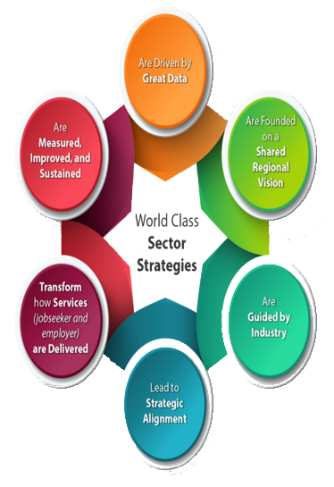
WIOA Increases Collaboration to meet the needs of job seekers and employers
SC partners align to meet the needs of industry
VR joins Sector Strategies teams across South Carolina
Notes:
First, let me provide you with a little background on how this change occurred. As you all know the Workforce Innovation and Opportunity Act increases collaboration between workforce development partners to ensure partners provide coordinated and complementary services allowing job seekers to more easily acquire the skills, training and credentials needed to meet employer requirements.
This emphasize on collaboration allowed us to be part of the Sector Strategies approach which encourages partners to work more closely together to meet the needs of industry.
As part of Sector Strategies, the state was divided into four regions with a VR representative on each team. The goal of these teams was to identify growing industry in each region so that we could pull together resources from all partners in order to develop an expanded pipeline of talent to better meet employer’s needs.

Slide 6
A Shift in Focus
 | In the Past | Going Forward
Our Relationship | Employers are customers | Employers are partners
Our Collaboration | Focus on labor exchange (e.g., good jobs, find referrals, etc.) | Industry employers design programs in collaboration with the workforce system
Our Services | As needed and provided by one agency at a time | Workforce system partners collaborate to create industry-wide solutions
Our Definition of Success | Individual placements for one employer at a time | Steady industry-wide talent pipeline and economic growth
Notes:
Here you see a diagram that explains how the Sector Strategies approach shifted our focus. Sector strategies emphasizes expanding workforce partners to also include businesses.
This means we now also see employers as partners who help us design our services to meet industry needs.
While we will remain focused on providing quality individualized services to VR consumers, we have increased our efforts to collaborate with our workforce and business partners to provide an expanded and steady talent pipeline to create industry-wide solutions.

Slide 7
New Approach to Talent Fairs
Change Leads to Success

Slide 8
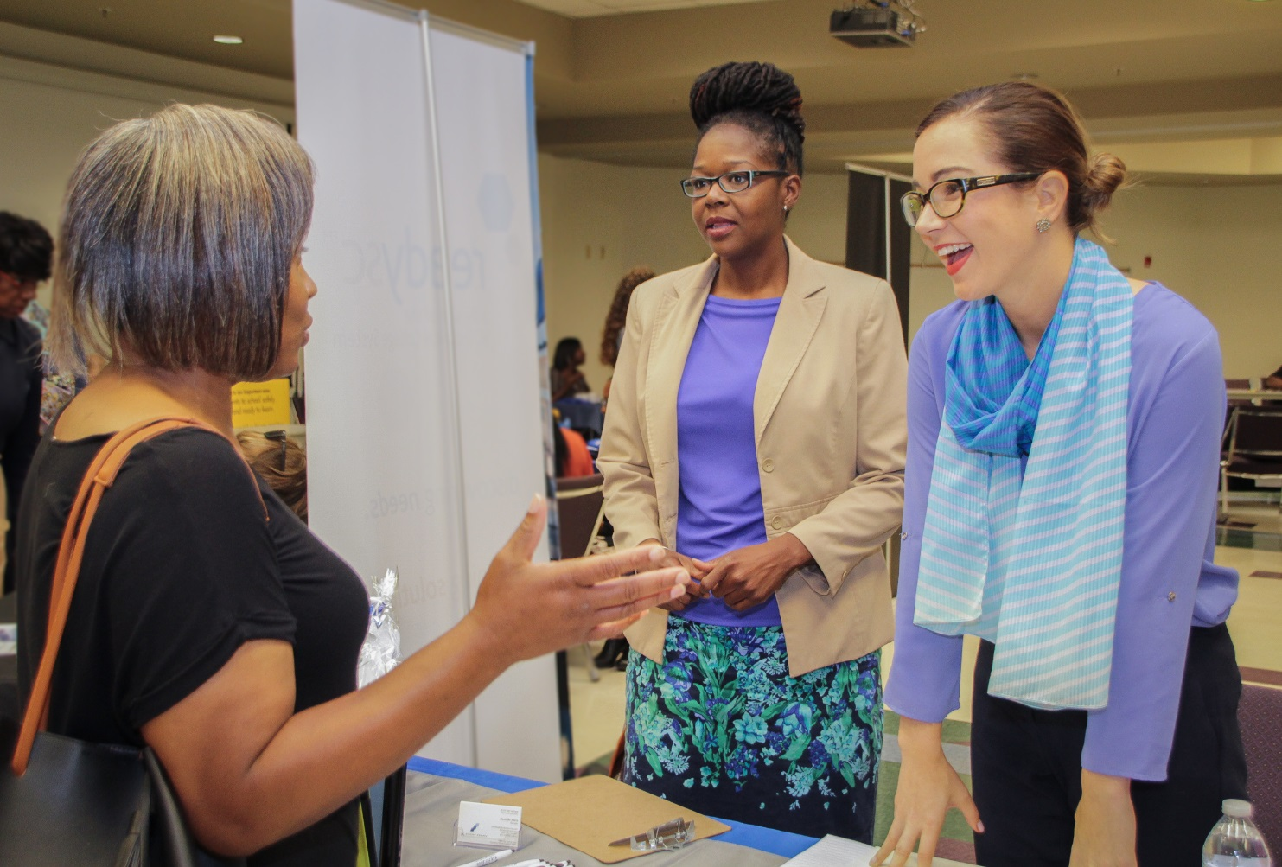
Talent Fairs allows us to….
Focus on in-demand sectors
match vocational objectives and training to the needs of industry
build customized training initiatives
scvrd.net
Notes:
By understanding that an employer’s time is valuable, a sector strategy approach was taken in making a change from holding job fairs to the use of talent fairs.
To better explain what we mean by talent fairs, I will share an example. In this particular example, we wanted to focus on one of the in-demand sectors in the Upstate region, which was Business Services. With our Business Applications Plus training that prepares consumers for careers in customer service and office support, including Business Communications, we felt we could provide well-prepared candidates to increase the pipeline of talent for that industry.
So the Talent Fair focused on having employers attend from the Business Services Industry and having VR Consumers attend with Vocational Objectives and training that matched that industry.
One business in attendance, BPO American (a local call center) was extremely impressed with several qualified candidates presented to them at the Fair. In this streamlined, more focused approach, they were also able to share, in detail, their needs for additional individuals with customer service training/experience.
As a result we were able to develop a partnership that led to a customized training initiative.

Slide 9
Customized Training
Change Leads to Success
Notes:
Now we will discuss the customized training that resulted from the Talent Fair…..

Slide 10
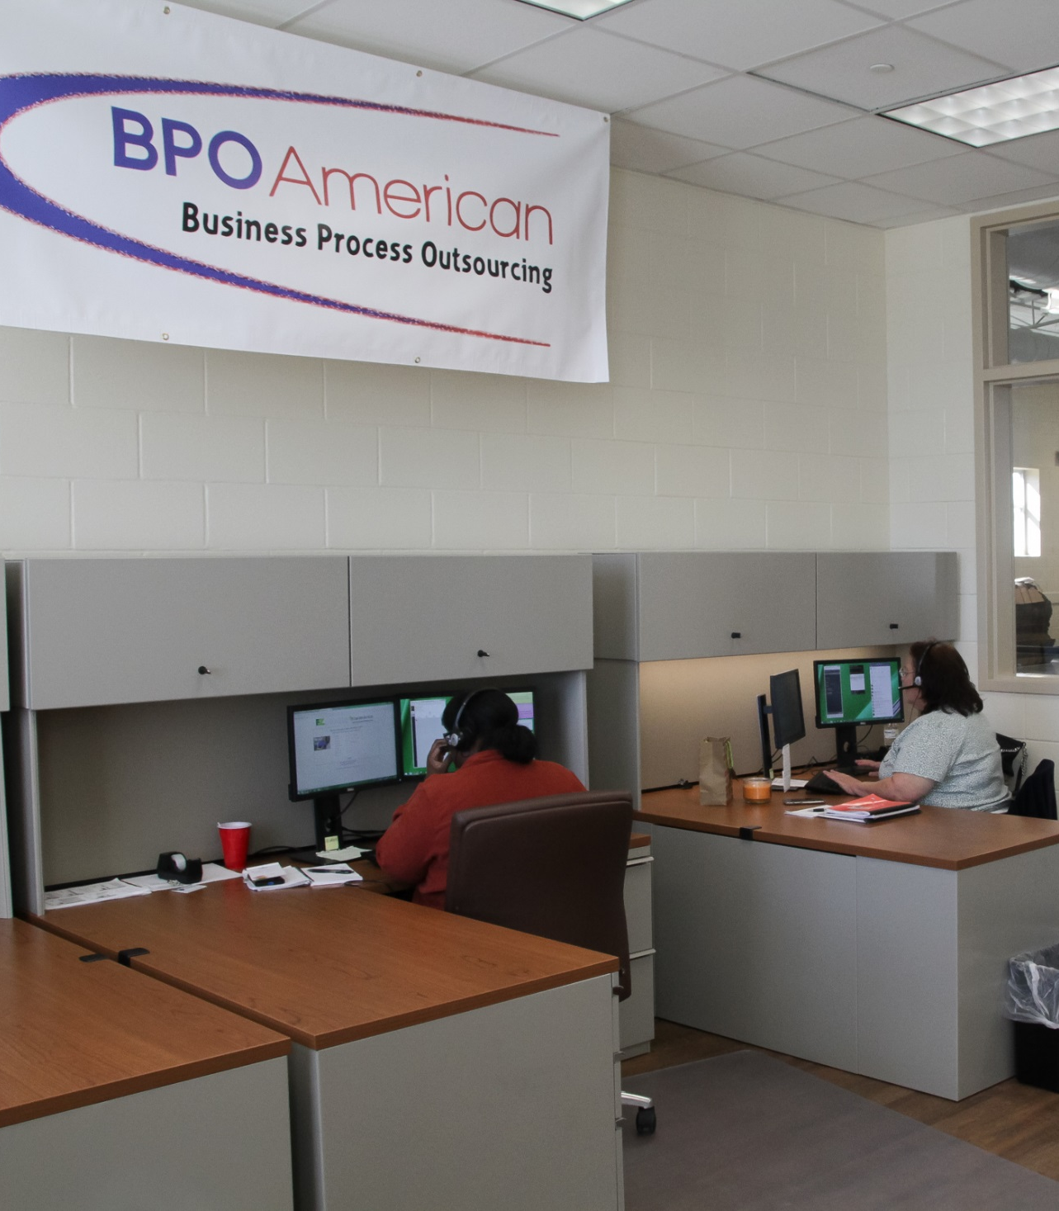
The training was developed according to industry needs
Training can be modified based on Consumer’s needs
Previous experience and/or training determines where they begin and how long they participate
scvrd.net
Notes:
A mock mini call center was set-up in our Lyman Training Center that not only provides VR Consumers with helpful skills, but provides a pipeline of talent to BPO American and other companies in the area who are in need of Customer Service representatives.
Before they enter the call-center training, we determine the level of preparation that may be needed. If an individual has very little prior customer service training or experience, we provide basic computer skills, soft-skills, and customer service training in-house through our Business Applications Plus program.
Some individuals with previous call center training or experience can enter directly into the hands-on call center portion of training.

Slide 11
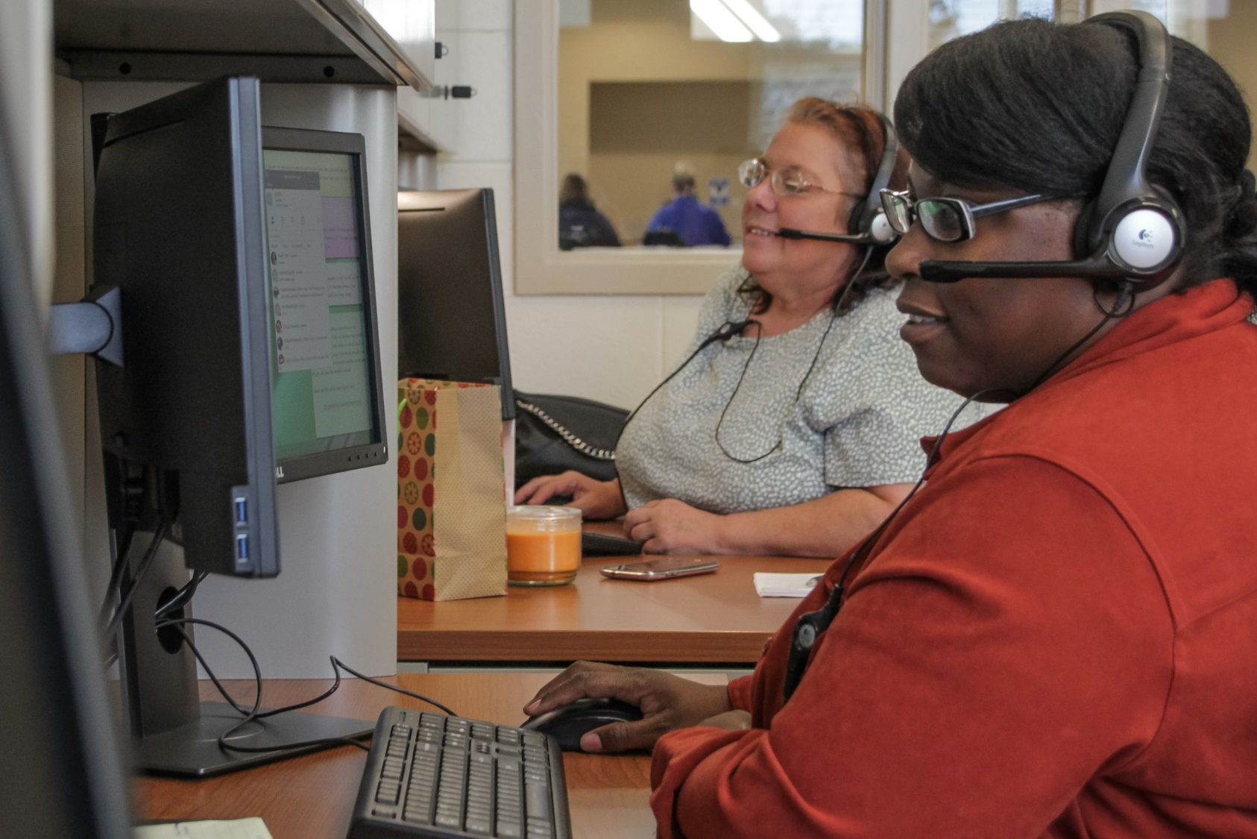
Trainees utilize “live calls”
BPO American provides an on-site trainer
Trainees progress in call volume, leads to hire
scvrd.net
Notes:
When in the hands-on call center portion of the program, they are trained first on mock calls from trainers calling in from BPO American and then “real calls” are slowly mixed in.
When the trainers feel the trainees are ready they begin receiving mostly live incoming calls which vary depending on the needs of the company.
Consumers receive calls to make reservations, pay traffic tickets, and relay messages to medical offices.
As training advances, the trainees variety of calls and volume increases.
The program is very individualized based on consumer’s progress and needs, so there is no set amount of time, but typically training averages 8 -16 weeks.
When BPO has opportunities available or openings with other companies are identified and the trainee has proven successful, an interview will be scheduled.

Slide 12
Results
Change Leads to Success
Notes:
And now to the most important part, Success!

Slide 13
Success:
More than 19 Consumers have participated in training.
Hires include:
BPO American 7
Sitel 4
TD Bank Customer Service 1
Visiting Angels Home Health Care 1
Home Instead Home Health 1
Other Customer Service Positions 2
Notes:
The training initiative has been very successful.
As you can see here, we have had a few that did not complete the program, mostly due to disability related issues, but for the most part we have had great success with the customized training initiative.
Since fall 2017 when the initiative began we have had 16 VR consumers that have entered into Customer Service jobs providing them with excellent career opportunities and filling the needs of industry in the upstate region of our state.
Overall, the partnership provides a talent pipeline for customer service positions to meet this industry’s needs, and provides VR consumers with good paying jobs and benefits.
We are excited to hopefully see this program grow and lead to many more successes.

Slide 14
Other Customized Training
Change Leads to Success
Notes:
As a result of our strengthened relationships through WIOA we have also built other customized training initiatives that have led to success for VR consumers.

Slide 15
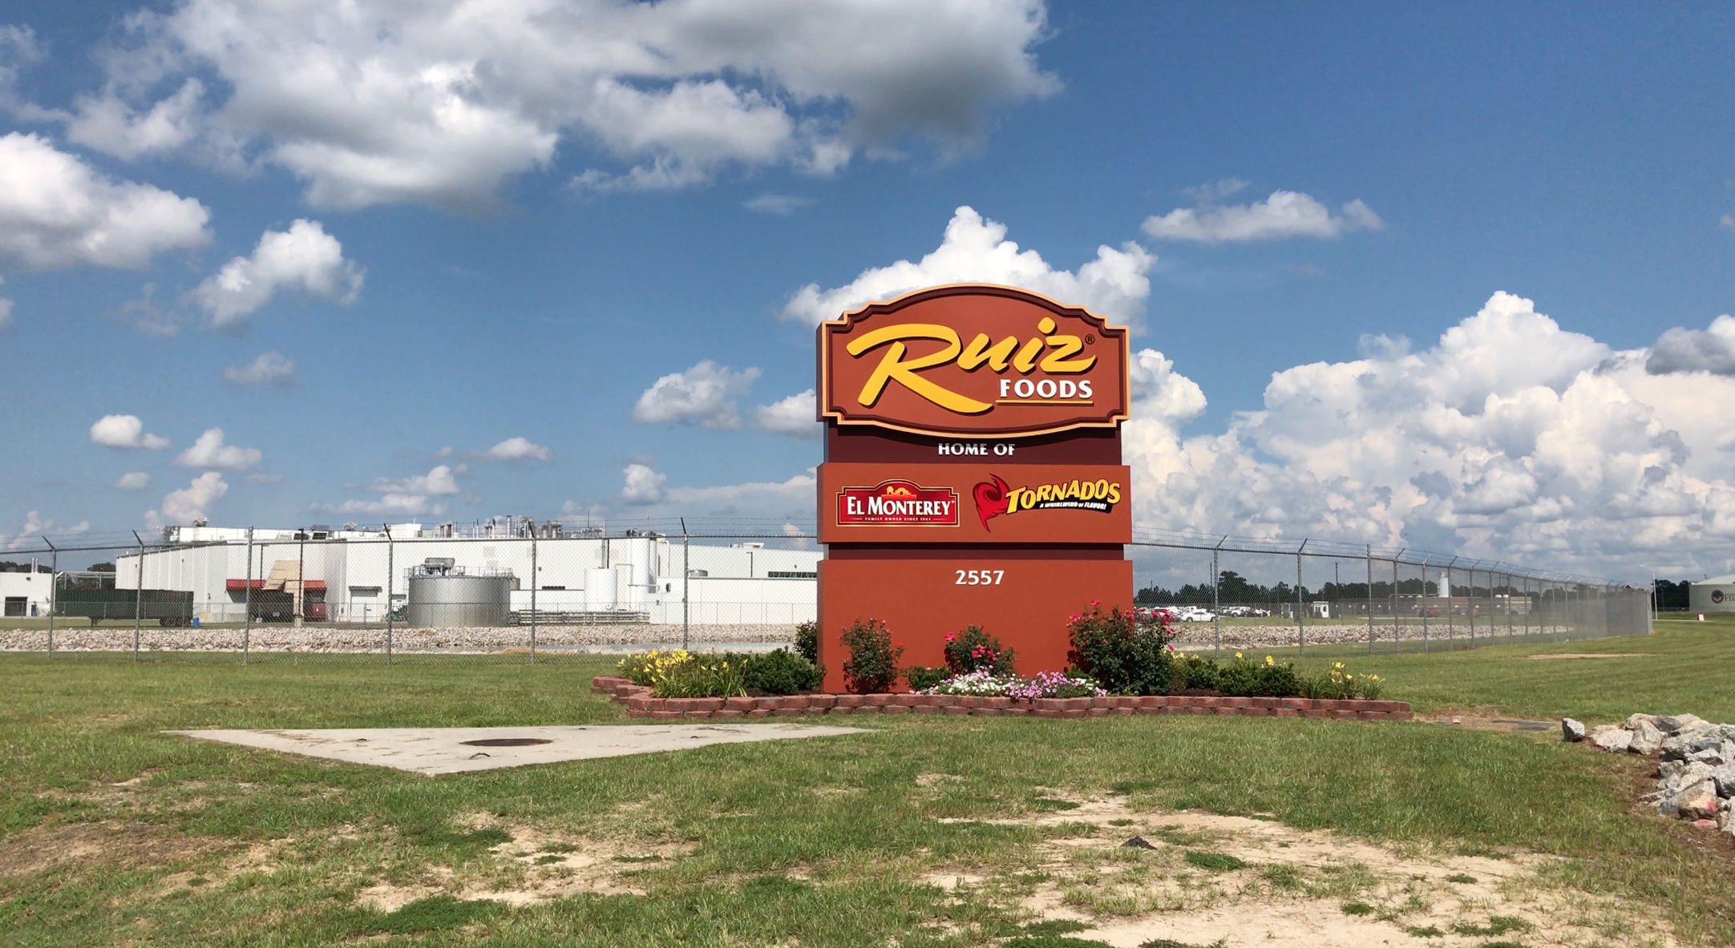
Technical college partnership
BDS established partnership with Ruiz Foods HR Manager in 2015
3 consumers hired into entry level positions
Ruiz Foods needed more skilled candidates
scvrd.net
Notes:
VR began a partnership with Ruiz Foods in 2015.
Initially, they hired 3 consumers into entry level positions.
The next year Ruiz Foods realized they needed not only more candidates but they needed skilled candidates.

Slide 16
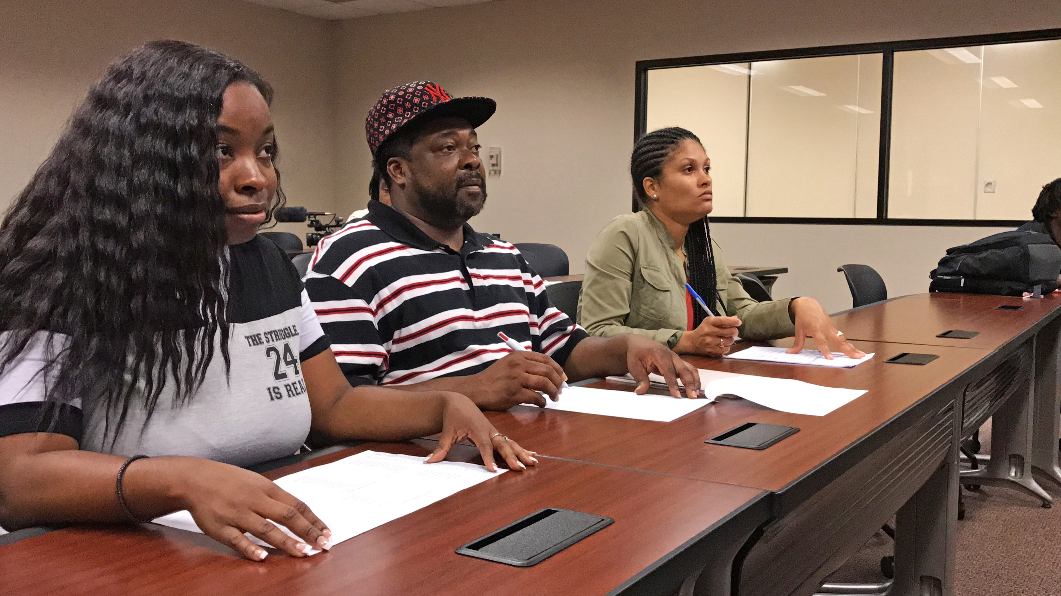
Consumers are assessed in the Work Training Center
SiMT customized Manufacturing Certification Program to meet Ruiz Foods’ needs
Training condensed to 1 week
Sigma Six certification
OSHA 10 certification
Fork Lift certification
After successful completion, candidates guaranteed interview
scvrd.net
Notes:
So the Business Development Specialist worked with the Southeastern Institute of Manufacturing Technology (SiMT) at Florence Darlington Technical College to customize their Manufacturing Certification Program to meet Ruiz Foods’ needs.
First of all, VR consumers are assessed in the Work Training Center before they are considered for training.
In the training, which is condensed to 1 week,
clients receive Six Sigma,
OSHA 10
and Fork Lift Certification.
After successfully completing the training consumers are guaranteed an interview.

Slide 17
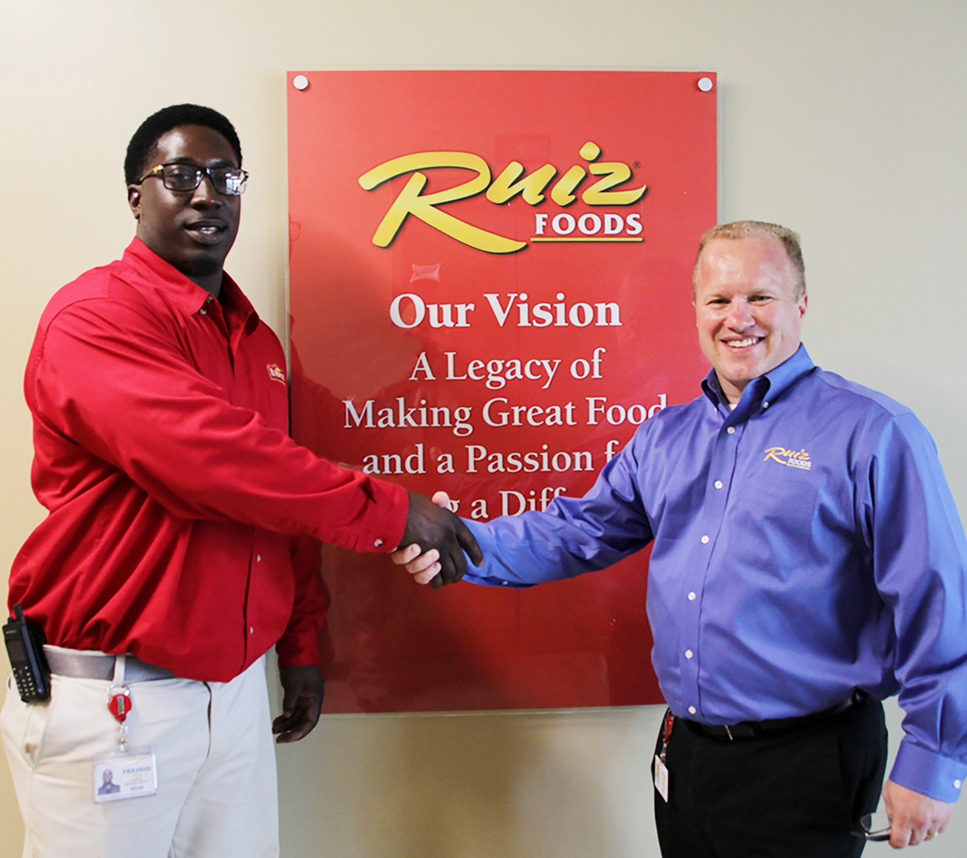
64 clients hired since Nov 2015
Consumers receiving promotions
Wages
Avg starting wage: $13 / hour
Avg wage after promotion: $22 / hour
scvrd.net
Notes:
To date 64 VR consumers have been hired by Ruiz since November 2015.
Not only are VR consumers getting jobs, but they are being promoted.
For example, Freddie Evans has been promoted to operations supervisor where he supervises 266 employees.
You can also see these are decent wages starting at $13/hr and an average of $22/hr after promotion.
And in addition to Ruiz we are finding this training that was originally customized for Ruiz is also meeting the needs of other similar industry in the area; VR consumers are finding opportunities with other employers as a result of the training.

Slide 18
Cathy Clower 843-740-1600 Ryan Skinner 864-327-5456 cclower@scvrd.net rskinner1@scvrd.net www.scvrd.net
Notes:
Back Cover Slide – place your contact information here or the general 1-800 number (1-800-832-7526 )

